Slide 1
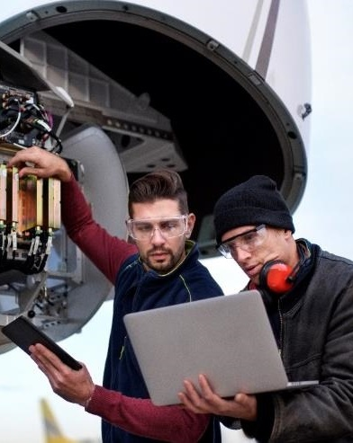
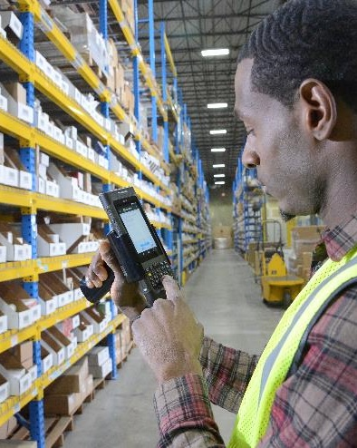
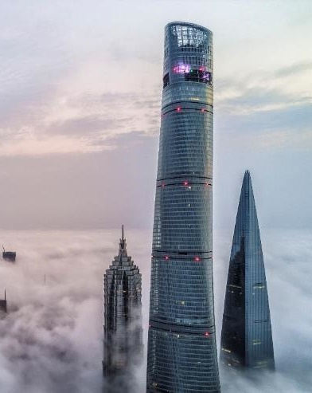


Genesis xp 7680g presentation scanner
Presenter’s Name
  Presenter’s Title

Slide 2
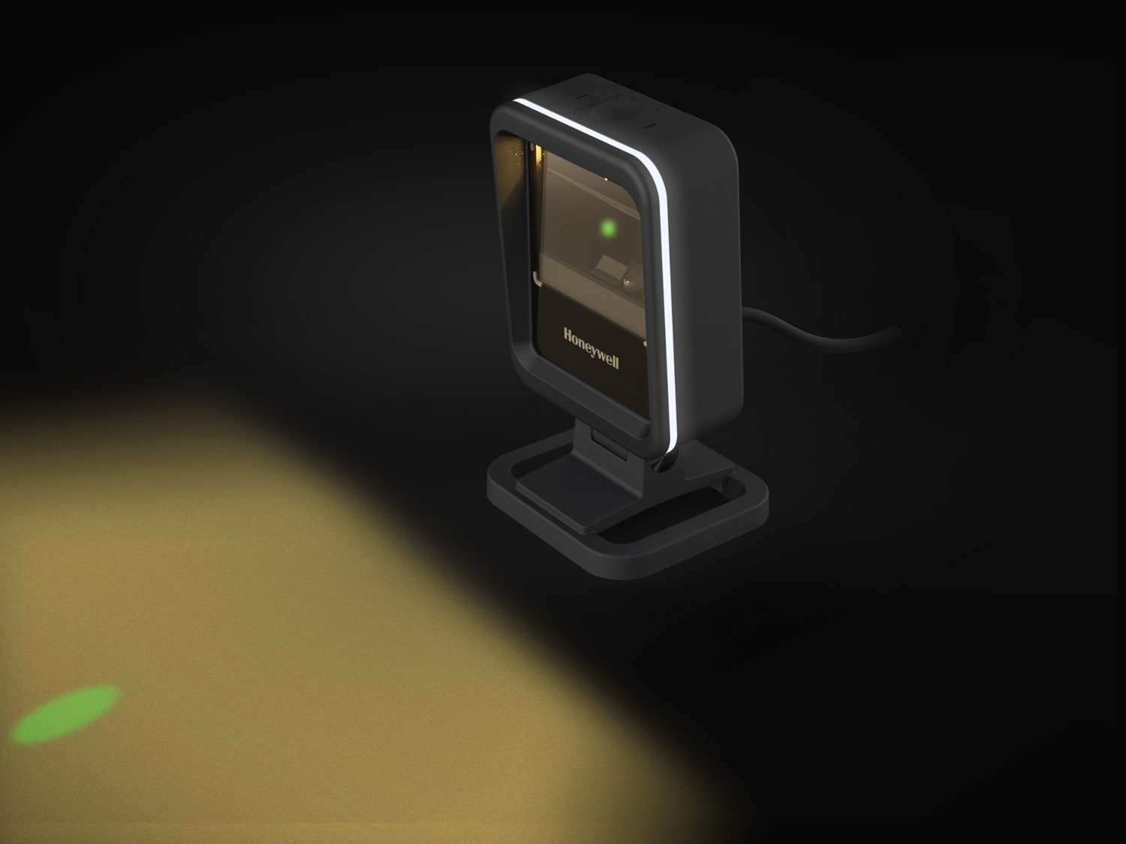
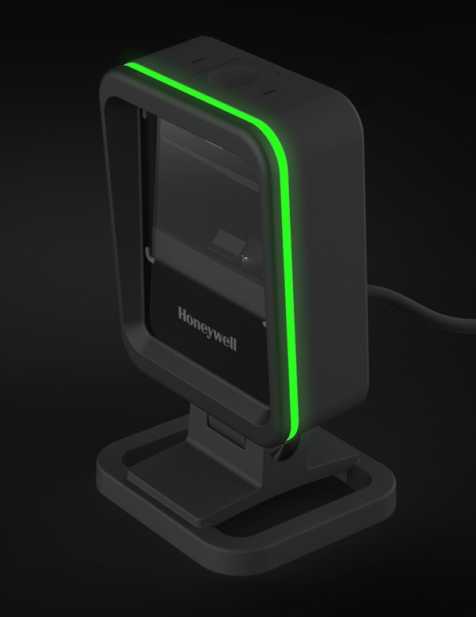
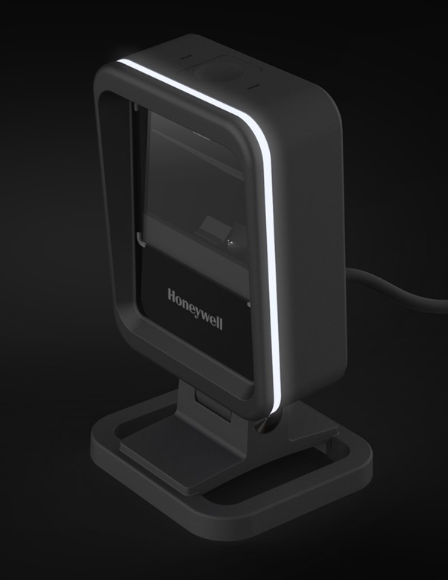
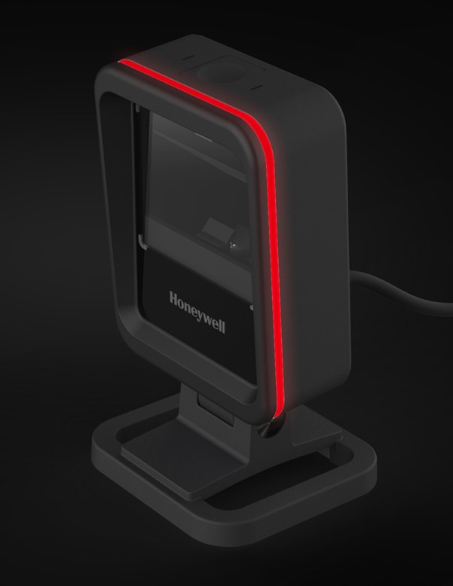
Genesis xp 7680g
flexible presentation SCANNER
February 2021
Honeywell Internal

Slide 3
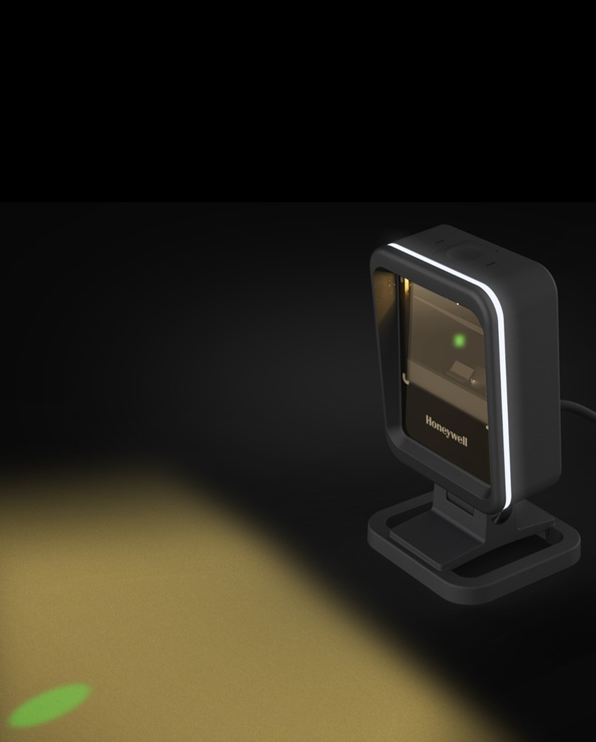

Introduction to your speaker
INTRODUCING
GENESIS™ XP 7680G
NAME
Title
Bio

Slide 4
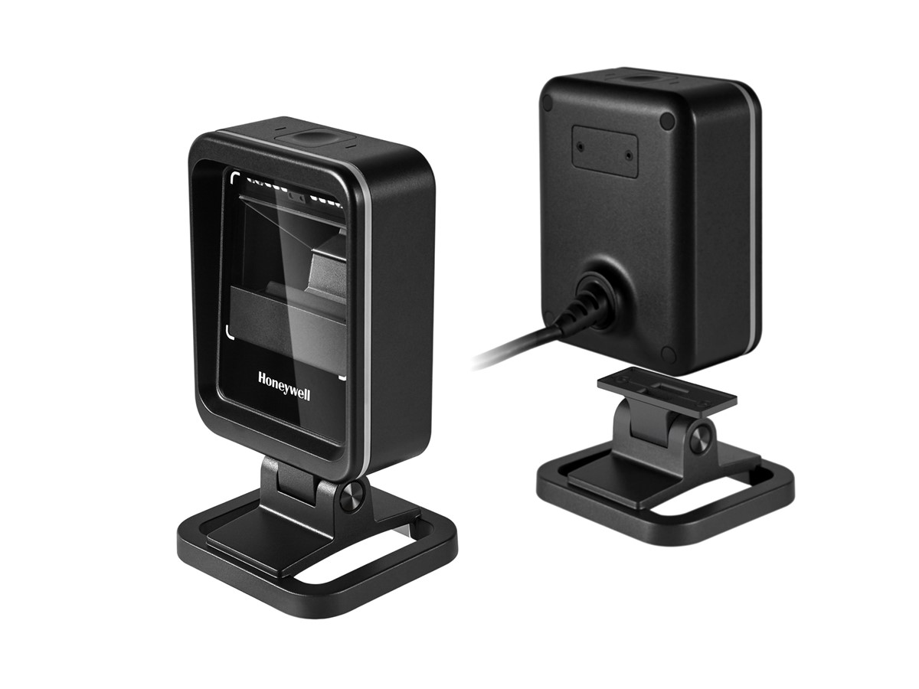
Sales presentation Contents
Product Introduction
Customer Challenge and Product Approach
Target Market and Applications
Customer Needs in Applications
Customer Value Proposition
New Features and Benefits with Genesis XP
Key Differentiating Features
Competitive Analysis
Pricing Strategy
Long Term Customer Value Through Workflow Optimization
Launch Timeline
Notes:
Russia:
HH400 lost to NLS？MD @$45 to customer, $35 to distributor
HH400 @$29 to distributor
Market Size All HH2D Corded Cordless
Premium $434 $159 $274
Entry+Mid High$148 $49 $99
Pricefighter $25 $20 $5
Total $607 $228 $378

Slide 5
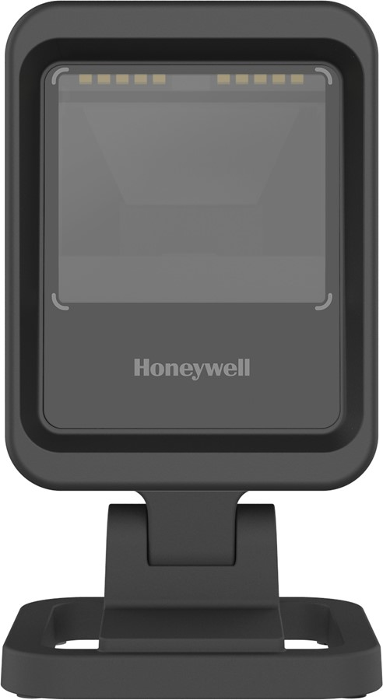
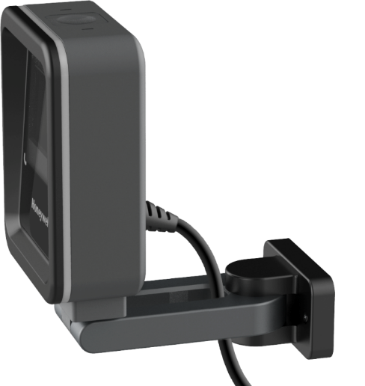
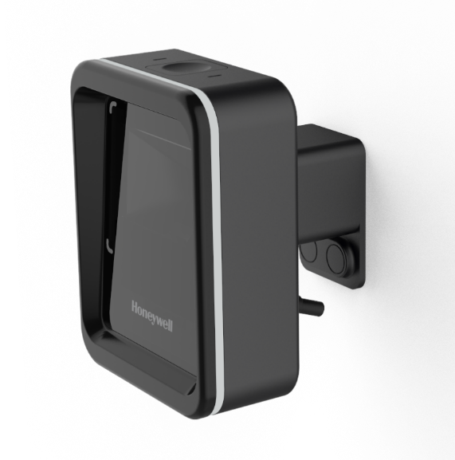
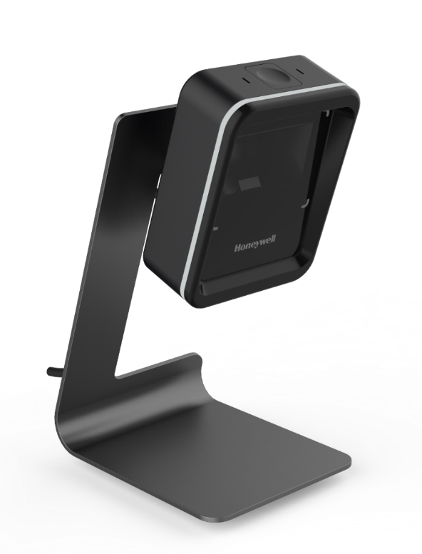
Honeywell Genesis™ XP 7680g
Flexible Presentation Scanner
Extreme (XP) Performance
Up to 20% faster scanning speed*, larger scanning sweet spot, and is backed by Honeywell’s proven XP technology.
Modern and Compact Design
Modern aesthetics in a compact design with a small footprint. Easy to clean, disinfectant-ready plastic housing with an IP52 rating.
Intuitive Targeting + Feedback
360° tri-color LED light ring provides intuitive barcode targeting and scan status feedback for easy-to-use interactions.
Flexible and Modular Design
Modular design with detachable stand that can adapt to specific workflow needs and easily integrate into almost any workflow with different accessories.
Smart Placement Accessories (coming soon)
Replace the accessory, not the scanner to accommodate changes in workflow, POS design and technology needs.
Hands-Free presentation scanning with proven XP performance in a flexible design that fits multiple workflows.
*compared current Honeywell hands-free scanners

Slide 6
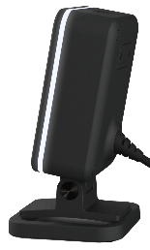
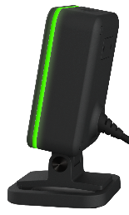
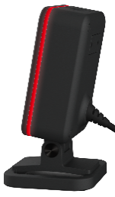

Genesis xp 7680g
Target Market
Presentation, counter-top or fixed mount applications requiring a large scanning target area, a high level of snappiness and relatively high motion tolerance
Contemporary retail environments demanding impactful customer experience and a scanner that is intuitive and pleasing to use
Hands-free presentation scanning with proven XP performance in a flexible design that fits multiple workflows
Feature
Key messages
Pain
points
Verticals and applications
XP Generation Scan Performance
Modern design with clean lines and small footprint
360° Color LED Ring
Warm, white illumination and IR Detect with Full-Off capability
Future accessories for a multitude of placement options
Increases customer productivity and better user experience
Impactful customer experience for contemporary retail
Intuitive and easy to use
Scanner is not a distraction to the consumer experience
Flexibility to adapt to the customer’s needs over time
Slow scanning or repeat scans
Scanner doesn’t fit retail image
Too much counter space
Reduce customer frustration
Avoid red illumination and illumination off when not in use
Counter-top placement is the only option
Boutique Retail
Fast Food
Convenience Stores and Gas Stations
Mobile Payment
Customer Loyalty Programs
Driver’s License Data Collection

Slide 7



Customer-driven solution
THE
CHALLENGE
Immediate
solution
Long-term value
All these considerations and more influenced the design of the Genesis XP
Completely new, modular platform design
Big focus on performance and ease of use
Modern design fits contemporary retail
Flexible solution for counter-top, POS mount, wall mount or kiosk applications
Performance boost for increased productivity and better experience
Ease of use and modern design support the customer brand message
Future accessories will allow Genesis XP to adapt to customer needs over time
Deliver a presentation scanning solution that meets the needs of modern applications
Improved performance
Intuitive and pleasing experience
Don’t be a distraction
Design that fits modern retail
Flexible for changing needs
POS Mount
Wall Mount
Vertical Mount

Slide 8
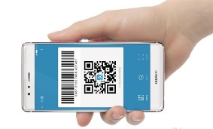
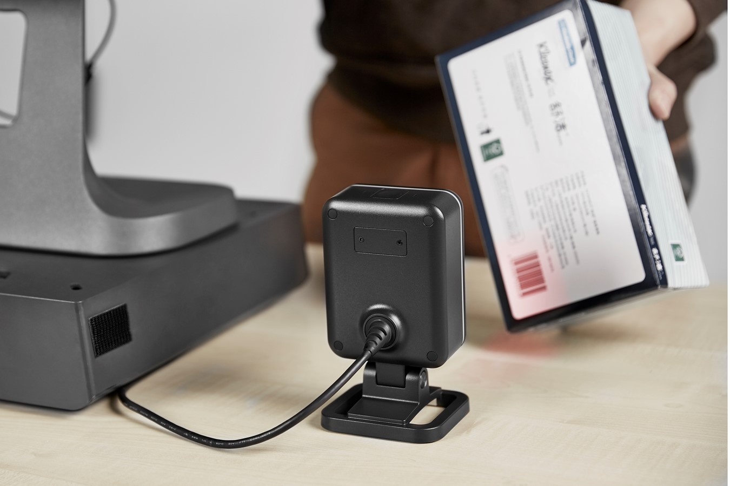
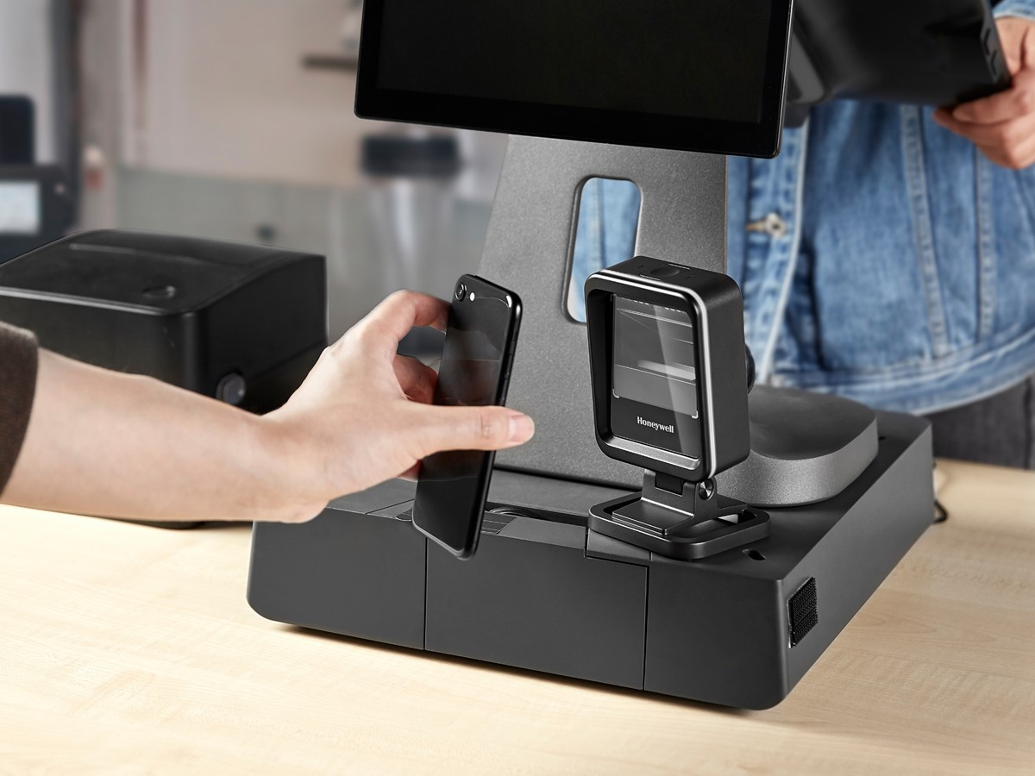
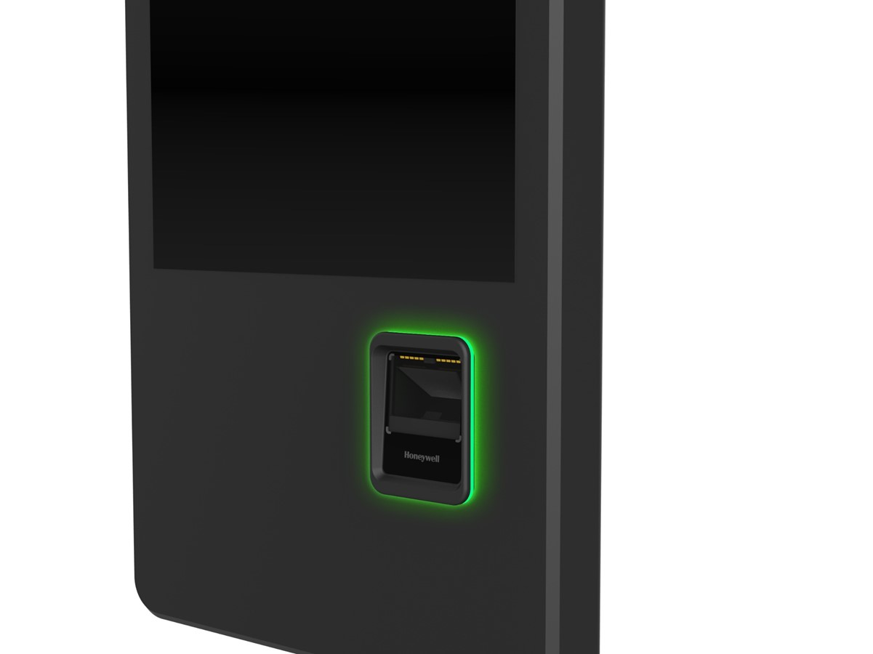
Customer Needs
Common Needs in Target Applications:
Counter-top or fixed mount applications
Customer facing user experience
Large scanning target area
Mobile phone scanning
High level of snappiness
Relatively high motion tolerance
Low to medium item throughput
Kiosk integration opportunities
A presentation scanner for counter-top or fixed mount applications requiring a large scanning target area, a high level of snappiness and relatively high motion tolerance
Hands-Free Scanning Applications with High Customer Engagement

Slide 9

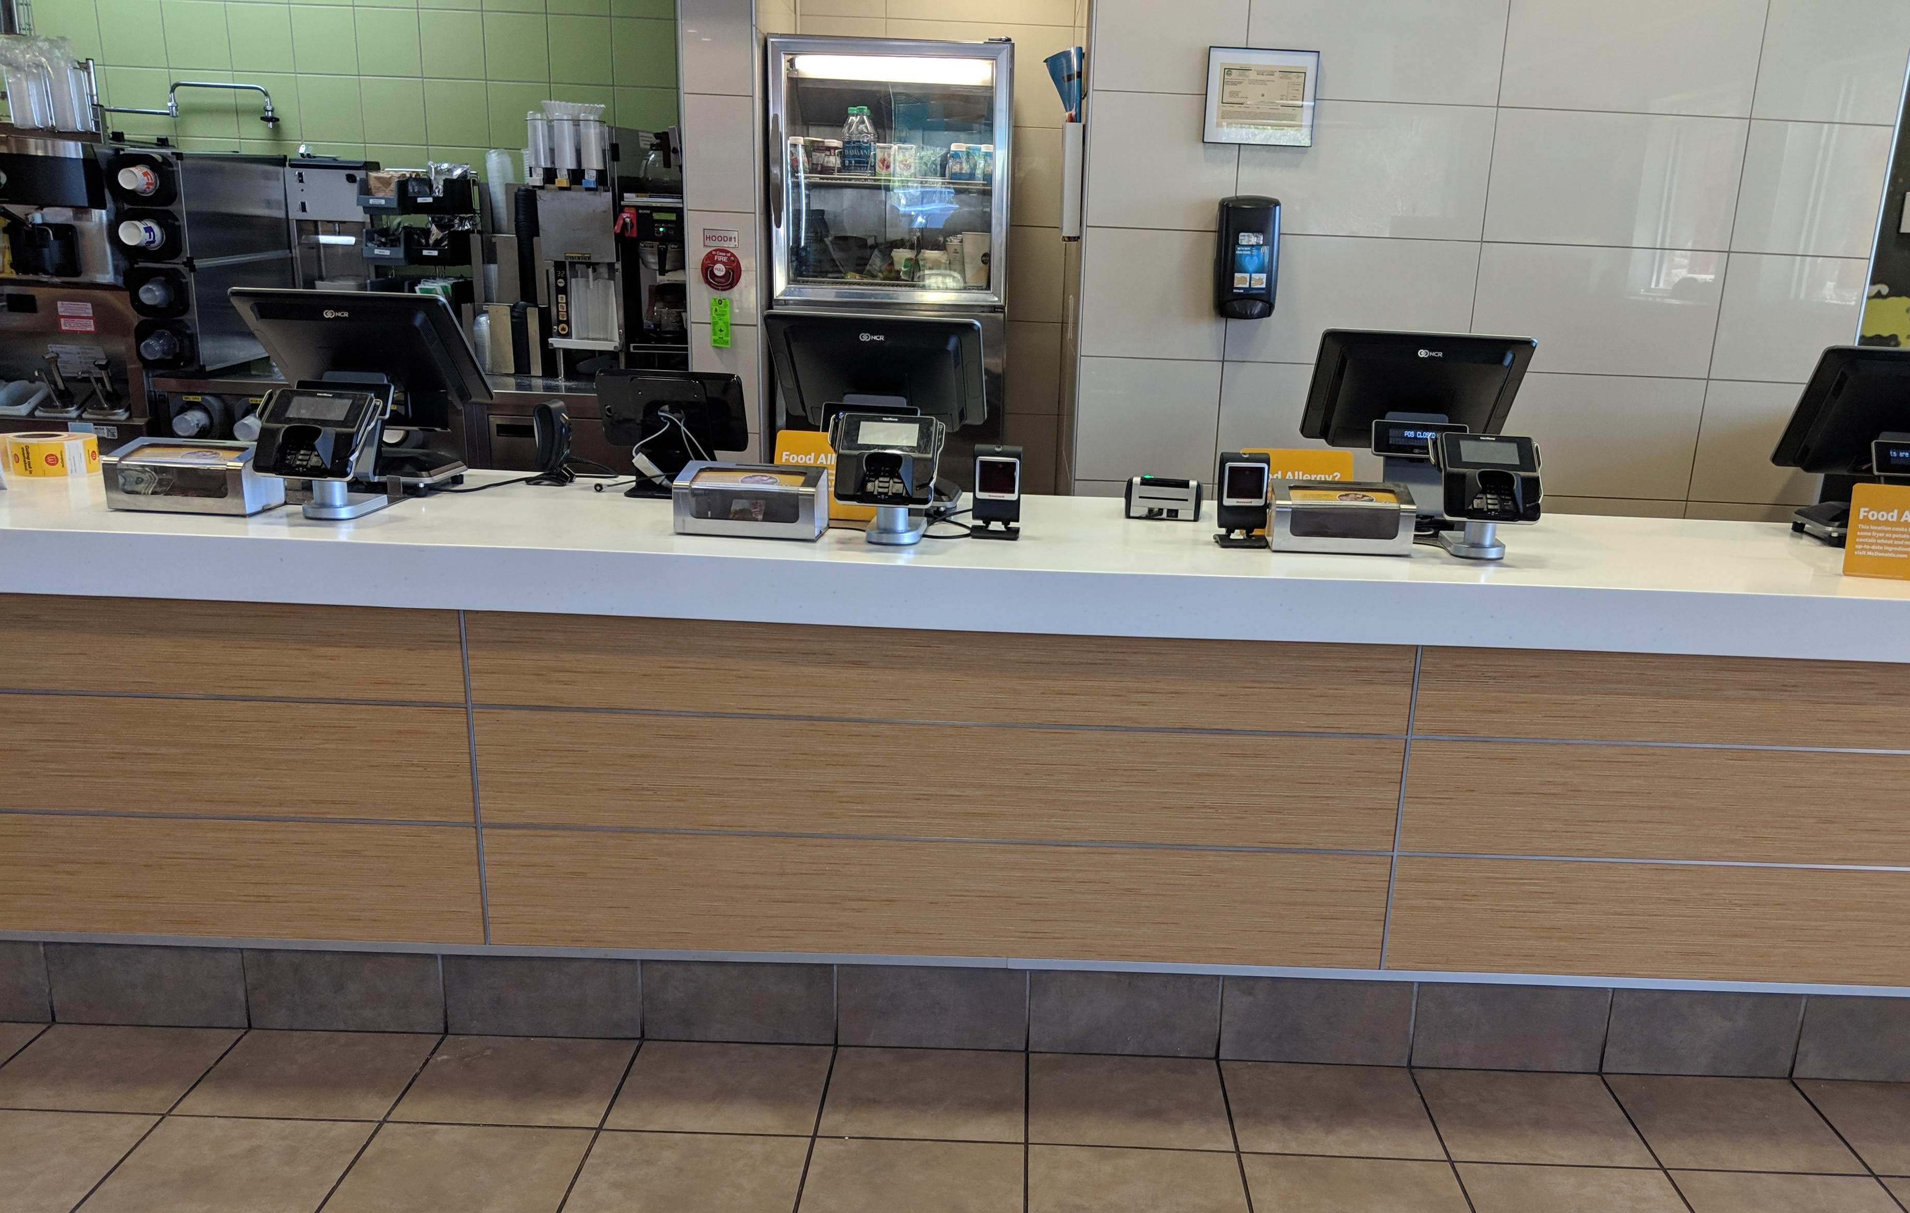

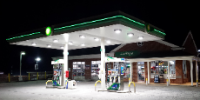
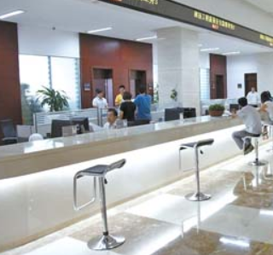
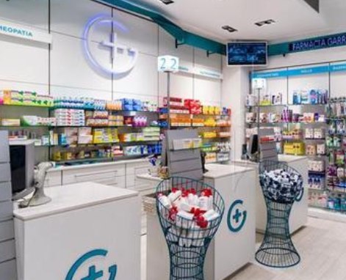


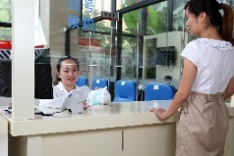

Target markets and applications
Target Markets
Target Markets
Retail Segment
Others
Boutique Retail
Fast Food
Small Format
Grocery
Convenience stores & gas stations
Public Service
Pharmacies
Target Applications
Retail Segment
Others
Medium throughput POS checkout
Mobile payment
Marketing loyalty programs
Admissions
Drivers License & Data Collection
Wide Variety of Markets and Application Opportunities

Slide 10

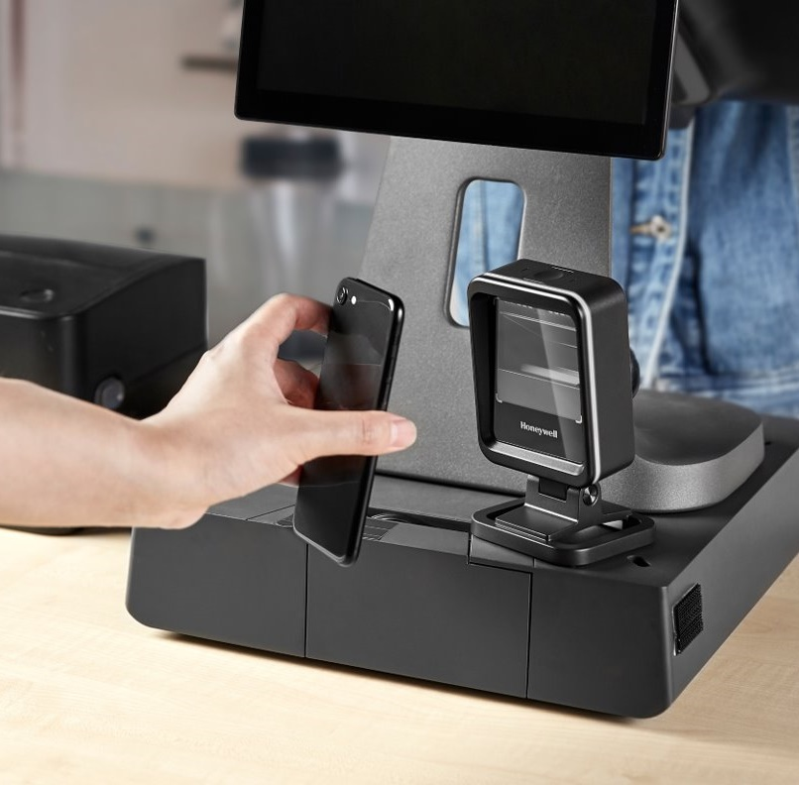
Genesis XP 7680g VALUE PROPOSITION
A new, modular hands-free presentation scanner featuring proven XP generation scanning performance in a flexible, modern design that fits multiple workflows.
Increased Productivity
Fantastic Customer Experience
Flexible and Simple Installation

Slide 11

Genesis XP 7680g customer value
    Increased Productivity– The Genesis XP features 20% faster scanning speed and larger scanning area than our current offering and features Honeywell’s field proven XP technology.
    Fantastic User Experience – The Genesis XP offers a fantastic customer experience in a compact and modern design
    Flexible and Simple Installation – The Genesis XP 7680g is backwards compatible with existing cabling and rapidly configurable with Honeywell’s suite of software tools and plug-ins such as EZ Config, SMU, OPOS/JPOS drivers, Easy DL™, EasyParse™ for GS1, and Honeywell Operational Intelligence
INCREASED PRODUCTIVITY
Extreme Scanning Performance
FANTASTIC CUSTOMER
EXPERIENCE
FLEXIBLE & SIMPLE
INSTALLATION
User Friendly Features
Intuitive Design
Backwards Compatible,
Honeywell Tools & Software Support
Increased Productivity, Fantastic Customer Experience, Flexible Installation

Slide 12

Performance benefits
Design Element
Large 1280 x 800 Image Sensor
Fast Scanning – Top Level Snappiness!
Resolution down to 3mil with Great Depth of Field
Superb Motion Tolerance of 4m/s
Print Contrast down to 20%
IR Object Detection – Auto Illumination On / Off
Large Scanning Sweet Spot
Customer Benefits
Increased Productivity
Super-fast Scanning Transactions
Strong Performance on Poor Quality Barcodes
Less Frustration or Repeat Scans
Easy to Use for Customers and Employees
Increased Productivity, Extreme Performance, Reliable Interaction

Slide 13
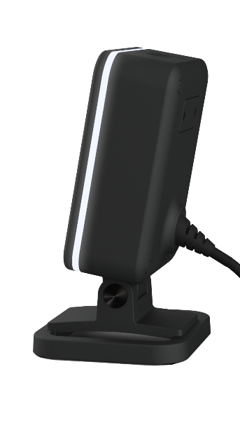
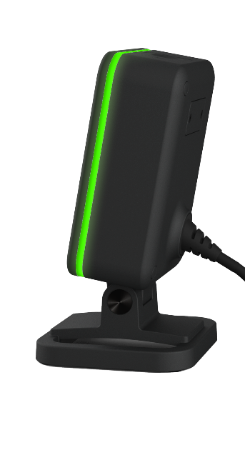
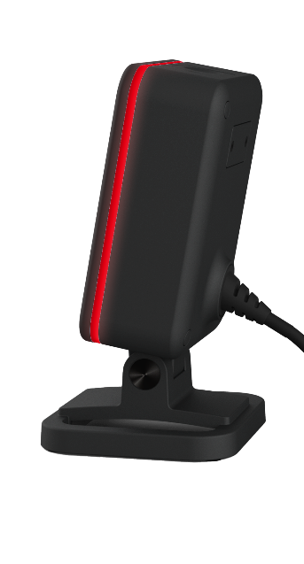
Customer experience benefits
Design Element
360° Tri-Color LED Ring
Warm White Light Illumination
IR Object Detection with Full-Off Illumination
Large Scan Window
Greed Dot Aimer with Large Sweet Spot
Top Button Trigger
Customer Benefits
Fantastic Customer Facing User Experience
Intuitive Interaction for Customers
Clear Feedback on Good Scans vs. Bad Reads
Warm White Light is More Pleasant than Red
Illumination Turns Off Automatically so the Scanner is not a Distraction
Large Scanning Sweet Spot for Easier Customer Interaction
Button Trigger Easy to Use for Manual Hand Scanning
Designed for a Fantastic Customer Experience

Slide 14
Flexible installation benefits
Design Element
Modern Design with Clean Lines and Flat Face
Detachable Stand w/ Adjustable Angle
Low profile strain relief cable
Honeywell Software & Configuration Tools
Backwards compatible with existing 7580g cables in the field
Backwards Compatible with 7580g Configuration Codes (for Existing 7580g Feature Set)
Future Smart Placement Accessories
Pin Connector on Rear Face will Support New Smart Accessories
Customer Benefits
Flexible and Simple Installation
Modern Design is more suitable for Contemporary Retail
No Need to Toss Existing Cables
New Cable has Improved Strain Relief for Easy Routing
Easy Placement Requiring Minimal Counter Space
Easy Setup and Configuration
Design Supports Easy Kiosk Integration
Future Mounting Accessories will Greatly Expand Placement Options and Flexibility
Pin Connector Future Proofs the Scanner for New Smart Accessories
Flexible Installation & Configuration, Backwards Compatible, Future Proof

Slide 15
7680g key differentiators
COMPETITIVE ADVANTAGES
Differentiated Feature | End User Value
20% Faster Scanning, Large Scanning Sweet Spot, 4m/s Motion Tolerance | Increase Productivity & Less Customer Frustration
360° Color LED Ring, Warm White Light Illumination, IR Object Detection | Impactful Customer Experience w/o Being a Distraction
Modern Design, Clean Lines, Small Footprint, Shorter Strain Relief Cable | Fits Modern Environments & Takes Up Less Space
Adjustable & Removable Stand, Future Smart Placement Accessories | Flexibility on Placement
Strong Drop and Tumble Specs, IP52 Rated, DRH Plastics Standard | Long Term Performance & Reliability
Snappiness
Motion Tolerance
Print Contrast
Warm White Illumination (Full Off)
Drop and Tumble Rating
360° Tri-color LED ring
Compact Profile and Footprint
Future Smart Placement Accessories
POSITIONING
Genesis XP 7680g offers significant performance and customer experience improvements over its predecessor the 7580g. The 7580g will go EOL by end of 2021.
Genesis XP 7680g is a step up in performance and functionality compared to our Orbit HF680.
Pricing: Genesis XP is targeted at similar price points as the current Genesis 7580g
Backwards Compatible: Genesis XP is backwards compatible with existing Genesis 7580g cables in the field
Honeywell Software / Tools: Genesis XP will be supported by EZ Config, SMU, OpIntel, UPOS, OPOS, JPOS, Easy DL, GS1, POS4NET

Slide 16
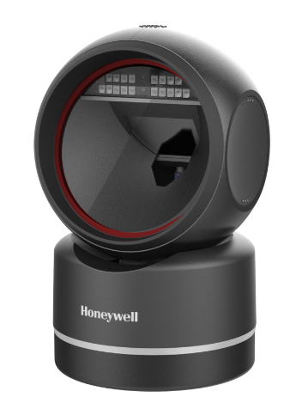
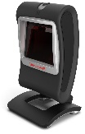
Honeywell’s presentation scanners
Attribute | Orbit™ HF680 | Genesis 7580g | Genesis XP 7680g
Design | Traditional | Traditional | Modern
Footprint | Bulky | Bulky | Compact
Accessories | No | No | Yes
DRH | No | No | Yes
Kiosk Ready | No | No | Yes
IP Rating | IP40 | None | IP52
Drops | 1m | 1.5m | 50 @ 1.5m
Tumbles | N/A | N/A | 1k @ 0.5 m
Image Sensor | 1280 x 800 | 832 x 504 | 1280 x 800
Snappiness | ++ | + | +++
Motion Tolerance | 2.5 m/s | 2 m/s | 4 m/s
Min Print Contrast | 20% | 20% | 20%
Resolution | C39: 3mil | C39: 4mil | C39: 3mil
DOF 13mil | 0-210mm | 0-188mm | 0-260mm
FOV | 47 x 30 | 46 x 28 | 48 x 30
Decode | 1D, 2D, PDF, Dotcode | 1D, 2D, PDF, Dotcode | 1D, 2D, PDF, Dotcode
Digimarc | No | Optional | Standard
OCR | No | Yes | Yes
User Feedback | LED Ring + Beeper | LED + Beeper | 360° Tri-Color LED Ring + Beeper
Illumination | Red | Red | Warm White
IR Detection | Yes | Yes | Yes – Full Off
Button Trigger | None | Top | Top
Integration Connector | No | No | Pin Connectors
The Genesis XP 7680g offers numerous performance and user experience enhancements over it’s predecessor the 7580g.
The Genesis XP 7680g offers key advantages over the new Orbit HF680 including:
  Better Snappiness
  Higher Motion Tolerance
  Longer Depth of Field
  Digimarc Standard
  Modern Design
  Warm White Illumination
  Better IP Rating of IP52
  Higher drop test performance

Slide 17
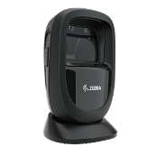
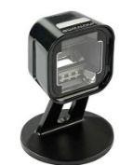
Genesis XP Competitive advantages
Attribute | Zebra DS9308 | Datalogic 1500i | Genesis XP 7680g
Design | Traditional | Modern | Modern
Footprint | Bulky | Compact | Compact
Accessories | No | ? | Yes
DRH | No | No | Yes
Kiosk Ready | No | Yes | Yes
IP Rating | IP52 | IP52 | IP52
Drops | 1.5m | 1.2m | 50 @ 1.5m
Tumbles | 1k 0.5m | N/A | 1k @ 0.5m
Image Sensor | 1280 x 800 | 1280 x 800 | 1280 x 800
Snappiness | ++ | + | +++
Motion Tolerance | 3 m/s | 1.5 m/s | 4 m/s
Min Print Contrast | 15% | 25% | 20%
Resolution | C39: 3mil | C39: 5mil | C39: 3mil
DOF 13mil | 0-224mm | 0-250mm | 0-260mm
FOV | 52 x 33 | ? | 48 x 30
Resolution | C39: 3mil | C39: 5mil | C39: 3mil
Decode | 1D, 2D, PDF, Dotcode | 1D, 2D, PDF | 1D, 2D, PDF, Dotcode
OCR | Yes | No | Yes
User Feedback | Light + Beeper | Light – Beeper | 360° Tri-Color LED Ring + Beeper
Illumination | Red | Red | Warm White
IR | Yes – Dim Only | Yes | Yes – Full Off
Button Trigger | Side | Top | Top
Integration Connector | No | No | Pin Connectors
The Genesis XP 7680g offers advantages over one or both of our key competitors, in several key areas.
Increased Productivity: Snappiness, Motion Tolerance, DoF, Print Contrast
Fantastic User Experience: User feedback via 360 Tri-Color LED Ring, Warm White Illumination, Automatic Object Detection with Full-Off Illumination, Disinfectant Ready Housing
Flexible Installation: Compact Footprint, Detachable Pivoting Stand, Smart Placement Accessories, Kiosk Integration Ready, Stronger Drop and Tumble Test Ratings
Source: https://www.zebra.com/us/en/products/spec-sheets/scanners/general-purpose-scanners/ds9300-series.html
Source: https://www.datalogic.com/eng/retail-transportation-logistics-healthcare/fixed-retail-scanners/magellan-1500i-pd-848.html

Slide 18
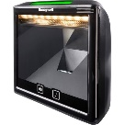
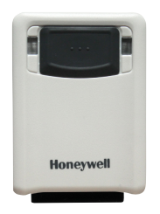


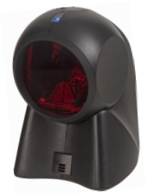
Hands-free Portfolio Positioning - $ASP
Solaris™ 7980g
Premium Application Segment
Vuquest™ 3320g
Performance Foused Segment
Genesis XP 7680g Price will be Comparable to current 7580g pricing
Win on Performance + Customer Experience:
Performance: Snappiness / Motion Tolerance / Depth of Field / Print Contrast
Customer, Experience: Modern Design, Intuitive Usability, Large Sweet Spot, Great UI Feedback
Flexible Installation: Small Footprint, Smart Accessories, Kiosk Ready
Technology: XP Proven Optics, ML Self-optimization, Intuitive LED Ring, PIN connector for future technology integration
Price
Zebra DS9308
Genesis 7580g
Genesis XP
7680g
Magellan 1500i
Youjie™ HF600
Orbit Hybrid
Price Focused Segment
Orbit HF680
Performance/Technology

Slide 19
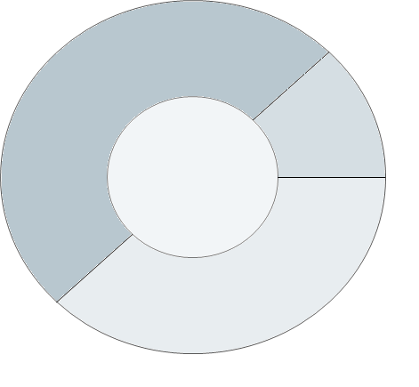
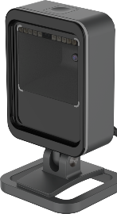
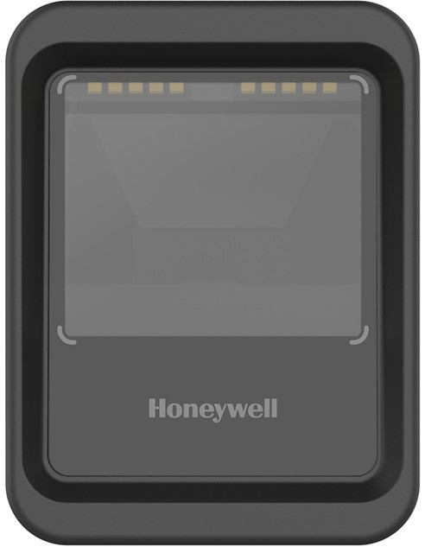



Genesis xp flexibility: workflow optimization through modular design
Flexible Configuration & Installation
Illumination, LED Ring, & Aimer are all configurable
Software Support
EZ Config, SMU, OpIntel
UPOS, OPOS, JPOS,
Easy DL, GS1, POS4NET
Workflow Optimization
Point of Sale:
Retail, QSR, C-Stores
Customer scanning:
Coupon, Loyalty, Mobile
Handheld Scanning:
HH mode enabled via top button Inventory, Customer Assist, Bin Pick & Scan
Backwards Compatibility:
with existing Genesis items:
7580g USB Cable
7580g RS232 Cable
7580g Configuration Codes (for 7580g feature set)
Kiosk Integration Ready
Modern design
Straight Edges
Flat Face
360° LED Ring
Swappable cord
Pin Connectors
Kiosk Ready
Presentation
Genesis XP 7680g
Scanning Module
with XP Gen 7 Technology
Future Flexibility from Smart Placement Accessories
Wall Mount
POS Mount
Overhead Mount
Coming Soon
Future Accessories
“Would buy modular scanner over singular use competitive device if pricing was similar.” – VOC Customer

Slide 20
Genesis xp 7680g offering
Region | Configuration | SKU Number in Price Book
US&C, LA | Scanner Only | 7680GSR-2-N
US&C, LA | Scanner + Stand | 7680GSR-2-1-N
US&C, LA | Kit: Scanner + Stand + USB Cable | 7680GSR-2USB-1-N
EU, MERTA, ROW | Scanner Only | 7680GSR-2-R
EU, MERTA, ROW | Scanner + Stand | 7680GSR-2-1-R
EU, MERTA, ROW | Kit: Scanner + Stand + USB Cable | 7680GSR-2USB-1-R
APAC | Scanner Only | 7680GSR-2-A
APAC | Scanner + Stand | 7680GSR-2-1-A
APAC | Kit: Scanner + Stand + USB Cable | 7680GSR-2USB-1-A
China | Scanner Only | 7680GSR-2-C
China | Scanner + Stand | 7680GSR-2-1-C
China | Kit: Scanner + Stand + USB Cable | 7680GSR-2USB-1-C
Japan | Scanner Only | 7680GSR-2-J
Japan | Scanner + Stand | 7680GSR-2-1-J
Japan | Kit: Scanner + Stand + USB Cable | 7680GSR-2USB-1-J
India | Scanner Only | 7680GSR-2-I
India | Scanner + Stand | 7680GSR-2-1-I
India | Kit: Scanner + Stand + USB Cable | 7680GSR-2USB-1--I
Offering Notes
Standard configurations shown to the left are in published price books
Standard configurations are all black in color ie. Black scan module, black stand, black cables
All standard offerings feature white illumination and will support Digimarc
Scan module is backwards compatible with existing Genesis 7580g cables and supported by Honeywell Scanning software and plug-ins
Note - Large Orders Only
RS232 Kits are available via PCR and will include scanner, stand, RS232 cable, power supply and adapter plug
White Color Available for Large Orders Only. White kits are available via PCR with white module, white stand and white cable.
EZDL / GS1 Available for Large Orders Only, via PCR
Digimarc optimized scan module available with red illumination via PCR
Note on 3rd India SKU: two dashes at end of PN, not a typo

Slide 21
Genesis xp 7680g Launch timeline
Feb
‘21
Mar
‘21
Apr
‘21
June
‘21
Genesis XP 7680g Timeline | Public Launch of Genesis XP | Manufacturing Launch / Order Placement Marketing Materials Available | First Customer Shipments | Launch of Smart Placement Accessories
Time to Build Excitement!

